Slide 1
Conditionals, Functions, and Vectors
Mack 2023

Slide 2
Learning Objectives
Understand the concept of conditionals in GDScript.
Learn how to write and use functions in GDScript.
Explore the use of vectors in GDScript.

Slide 3
Conditionals
Conditions are an important part of programming, and they are used to check if a certain statement is true or false. This allows us to create branching code, where certain lines of code are only run if a certain condition is met. In this lesson, we will look at how to create conditions in GD Script.

Slide 4
Equality Operator
One easy example of a condition is the equality operator (==). This allows us to check whether two values are the same. For example:
5 == 5 (returns true, because 5 is the same as 5)
3 == 7 (returns false, because 3 does not equal 7)

Slide 5
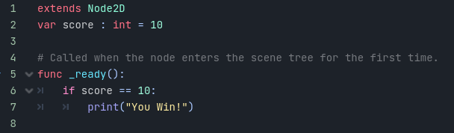
If Statements
If statements are an extremely important part of programming. They are used to check if a condition is true, and if it is, run the block of code within the statement. This allows us to create branching, dynamic code that will run different sections depending on the conditions given.
Notes:
Inside the Script Editor, we can create an integer variable called score and set it to 10. Then, in the _ready function, we can create an if statement to check if the score is equal to 10. If it is, then we can print the message “You win!”.
You will notice that the code in our if statement is indented one further than the code in our function. This is because GD Script uses indentation to know what part of the code is in each section. To write code outside the if statement, it has to be in line with the if statement to still be in the _ready function.

Slide 6
If Statements
If you press Play to test the code currently, you will see the You win! message is shown in the Output window. However, if you change the score value to something other than 10, the message will no longer be printed, as the score == 10 condition in the if statement returns false, so the block
of code inside it is no longer run.
If we placed code after the if statement in the _ready function, that code would just be run straight away, skipping over the if statement as it is false.

Slide 7
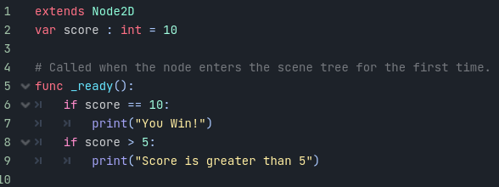
Other Operators
Aside from the equality operator, there are other operators that can be used in conditions. For example, we can use the greater than operator to check if a value is greater than another. To do this we will create another if statement, remembering to place it in line with our previous one so that it can run if score == 10 returns false. In this if statement, we will check if the score is greater than 5, using the > symbol.
Notes:
Here we check if score is more than 5, and if so it will print a String. With this set up you should expect the following outputs depending on your score value:
Score value less than or equal to 5: No output
Score of more than 5 but less than 10: “Score is greater than 5”
Score of 10 or more: “You win!” and “Score is greater than 5”

Slide 8
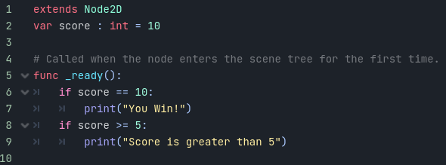
Other Operators
Currently, we are only checking if score is more than 5. We could check if the score was more than 4, or alternatively, we can check if the score is more than or equal to 5. To do this we use the >= symbol.

Slide 9
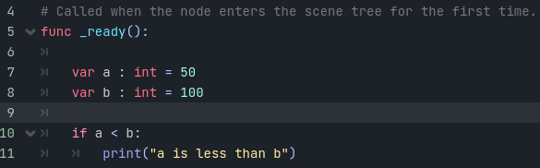
Other Operators
In addition to greater than, we can also use the less than operator in the same way, using the < symbol. To try this we’re going to create two variables to work with. We will create a variable a with a value of 50, and a variable b with a value of 100. We can then use an if statement to see if a is less than b and then print something if they are.
Notes:
In this example, the message a is less than b will be printed because 50 is less than 100 meaning the if statement will run. If we change b to 50 (or lower), then the message will not be printed because 50 is not less than 50.

Slide 10
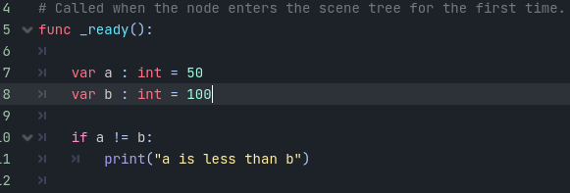
Other Operators
Finally, we can also use the not equals operator to check if two values are not the same. To do this we use the symbols !=.
Notes:
If you press Play you will see this message is also printed to the Output window, as 50 is not equal to 100, which the variables are set to. If a and b were set to the same value, the code would not run.

Slide 11
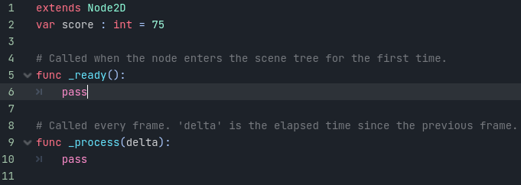
Else Statements
We will be expanding our knowledge of if statements by learning how to use else if and else statements.
Before creating any elseif/else statements, we first need a variable to use for testing. We will call this variable score, which will be of type int. We will set the default value to 75.

Slide 12
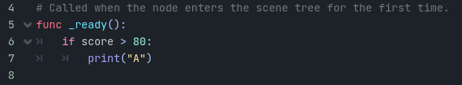
Using an If Statement
In the ready function, we will be writing code that will print out A, B, C, or D depending on the value of score, with 100 being the best and 0 being the worst. We will start by writing an if statement that checks if the score is greater than 80. If it is, then we will print out the letter A.
Notes:
As we covered in the previously, if the score is not greater than 80, then the code will not run. So if you press play you will see no output, as our score value is currently 75.

Slide 13
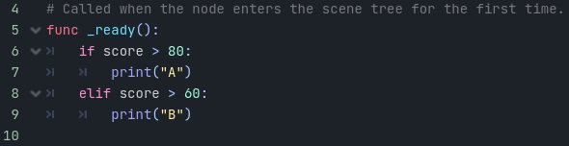
Using an Else if Statement
For our next value, we can use an else if statement to check if the score is greater than 60. If it is, then we will print out the letter B. In GD Script we use the elif keyword to specify an else if statement.
Notes:
An else if statement will only run if the if statement above it returns false. This is like asking the question: if the score is not greater than 80, then is it greater than 60? If the answer is yes, then the code will run. If the answer is no, then the code will not run. As our score is less than 80, but more than 60, you will see that we get the B output if you press the Play button to run the code.

Slide 14
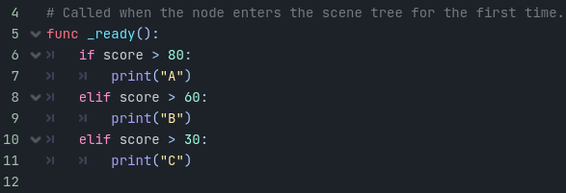
Using an Else if Statement
You can also chain else if statements and they work in the same way. However, in this case, it checks if the else if statement and all statements before it have returned false before running. We can test this by adding another score check for values above 30.
Notes:
You can then stack as many of these else if statements as you want, to create a chain to check for different events.

Slide 15
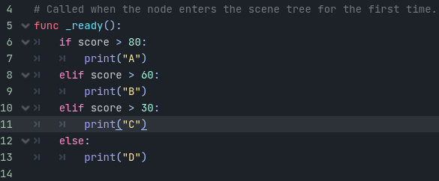
Using an Else Statement
Finally, we can use an else statement to print out the letter D. This statement is placed at the end of the chain of if statements, and will run when every if and else if returns false.
Notes:
In this case, D will be outputted when score is set to 30 or lower, as all the if statements above it will return false.

Slide 16
Functions
Like variables and conditions, functions are another extremely important part of programming. We will be covering the basics of using functions in our code along with how they integrate into Godot itself. So, what is a function? A function is a block of reusable code that we can tell the computer to run, such as a jump function that allows the player to jump.

Slide 17
Ready and Process Functions
We have already looked at two functions within GDScript, the _ready and _process function. We have used the _ready function to run code when the game starts, as Godot calls it when we press the Play button. The _process function is also used by default in Godot, and is called once every frame.

Slide 18

Creating a Custom Function
We are not limited to using GDScript’s built-in functions, we can also create our own functions. To do this, we first need to write the keyword func, followed by the function name, we will be using _welcome_message, finally add two brackets (these will contain our parameters when we cover this later), and a colon, and then go to a new line to complete your function declaration.

Slide 19
Creating a Custom Function
If your function is empty you can place the keyword pass to show GDScript that you intend to add functionality here later, otherwise, it will cause errors as GDScript expects there to be at least one line of code in a function. You can see the pass keyword in the _ready and _process functions as well, where Godot has created the functions by default, but doesn’t expect you to add code to them straight away.

Slide 20

Creating a Custom Function
In our case, we want to add a print statement to our function so that we know when it has been called.

Slide 21
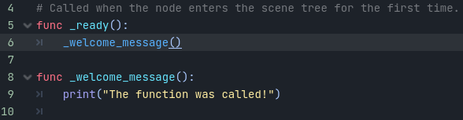
Calling a Function
To call a function, we simply need to write out the function name and add two brackets. We can call a function from any other function, for example, we will call our _welcome_message function from Godot’s _ready function as that will mean it is run when the game starts.
Notes:
If you save and press Play, you will see that we get The function was called! appear in the output window, as the _welcome_message function gets run.

Slide 22
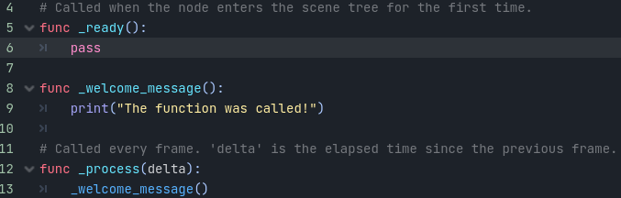
Calling a Function
We can do the same thing in the _process function.
Notes:
This will result in the function being called once every frame, and therefore many messages appear in the Ouput window every second.

Slide 23

Function Inputs
Functions can also take inputs and give outputs, known in GDScript as parameters, and return values. We can provide information to a function by sending parameters, such as the delta parameter in the _process function, which is like a variable passed into the function.
To try this ourselves, we can create a function called _add that takes two numbers as parameters and adds them together. We will do this by placing the parameter names a and b in the function’s brackets, with a comma separating them.

Slide 24

Function Inputs
By writing this line of code we are telling GDScript that we want to create a function called _add that requires the parameters a and b to be passed when it is called. To use these parameters we can create a variable called sum that is equal to a + b.
Notes:
This will take our parameters, add them together, and store them in the variable named sum. We can then print the result to see what happens.

Slide 25
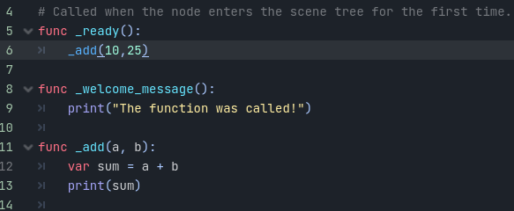
Function Inputs
We can then call this in the _ready function and pass our parameter values in the brackets, separated by a comma. We will be using the values 10 and 25.
Notes:
As expected, this will result in an output of 35.

Slide 26

Function Outputs
Functions can also return values when they are complete. To do this, we will replace the print command with a return line, that will return the sum variable.

Slide 27
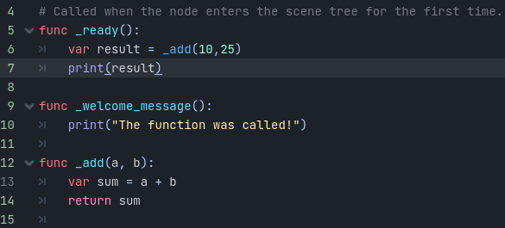
Function Outputs
This will now return the sum variable’s value to where the _add function was called from. We can then save this in a new variable, which we will call result.
Notes:
You can also add a print command to output the result variable so that we can see what the return command has returned. This will show 35 in the Output window, as this is the same return value as we were printing from the _add function earlier.

Slide 28
Vectors
Vectors are an important concept in game development, and they are used to represent a position or direction in code. In 2D a vector would represent the X and Y axes, while in 3D, it would represent the X, Y and Z axes. In this lesson, we will look at how vectors are used in the GD Script and how they integrate into Godot itself.

Slide 29

Using Vectors in Godot
2D Vectors are used in Godot to represent the X and Y axis values of something. One example of this is a node’s position property, which can be modified in the Inspector with any 2D node selected.
Notes:
As you can see, the position property has both an X and a Y value, as this is actually a vector.

Slide 30
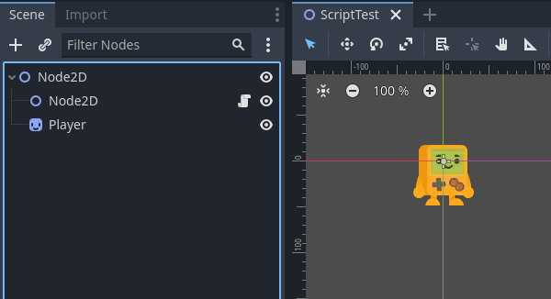
Using Vectors in Godot
We can add a Player.png sprite node into the scene to help test this.

Slide 31
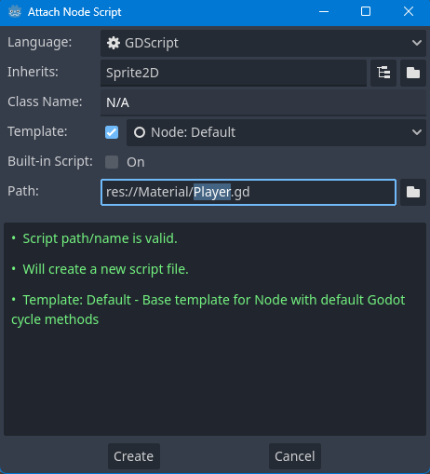
Using Vectors in Godot
We can then attach a script to this node, to try setting the node’s position from a script.

Slide 32
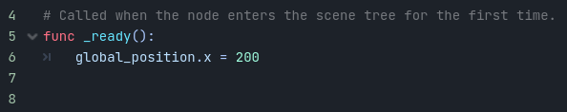
Using Vectors in Code
To access and modify a node’s position in code, we use the global_position variable which is used to get and set the node’s position. We can then access the X and Y values individually by placing
a dot in between the name and the property. We can try this by setting the x position to 200 in the _ready function.
Notes:
If you save this script and press the Play button you will see the sprite is moved 200 pixels to the right, as we set in the code.

Slide 33
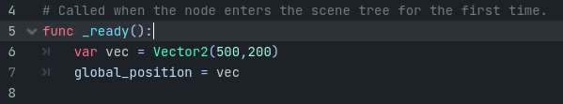
Using Vectors in Code
We can also create our own vectors instead of setting the position vector individually. We can create our own vector variable and then assign this vector to the node’s position to move our Player node to the desired location.
Notes:
If you run this now, you’ll find the player is moved 500 pixels right on the x-axis, and 200 pixels downward on the y-axis.
This knowledge can also be transferred onto 3D, with the only difference being the additional Z axis. You also need to use Vector3 instead of Vector2 when declaring a 3D vector, so that you can use the additional Z value when creating it.

Slide 34
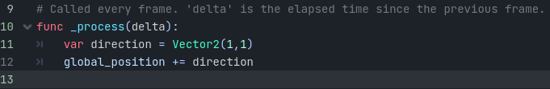
Moving Along a Vector
We can also use vectors to move a node in a certain direction every frame. We will do this in the _process function. The first step will be to create a variable called direction, using the X and Y values to show the direction we want to go. We will use (1, 1) to have a direction of moving down and to
the right. We can then add this to the global_position value in the _process.
Notes:
If you now press Play you will see the sprite move diagonally in the direction we set.

Slide 35
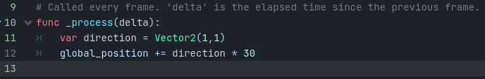
Moving Along a Vector
One option to change the speed of this would be to change the direction vector itself, however, this isn’t as easy to edit. Instead, we can multiply the direction value by how many pixels per frame we would like to move. In our case, we will use a value of 30.

Slide 36
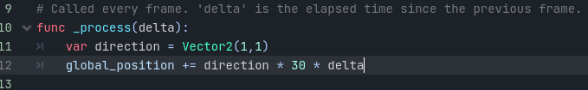
Using the Delta Value
However, if you press Play now you will see the Player node moves extremely quickly. This is because we are using 30 pixels per frame, and not 30 pixels per second. To change our value to the latter, we will multiply everything by _process‘s delta value, which converts per-frame values to per-second values.
Notes:
Now when you press Play you will notice the node moves much slower across the screen, at 30 pixels per second as expected. You can also change the speed of the movement, by changing the 30 value to anything else, such as 100 to go faster.
It’s important to use delta where possible, as this will make sure speeds are consistent across computers. Without using delta, computers that run at a faster frame rate will have objects move quicker, which is not what we want in most cases.

Slide 37
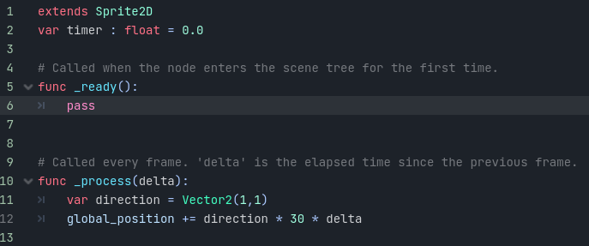
Using the Delta Value
Finally, we could also create a timer for our movement, by creating a float variable outside of the _process function.

Slide 38
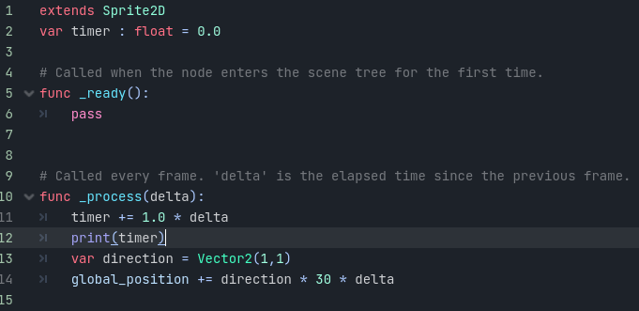
Using the Delta Value
To keep track of the seconds that have passed, we can add delta to timer inside the _process function.
Notes:
This way, if you press Play you can see the results of adding delta to the timer value in the Output window.

